Slide 1
Middle School at Arrowcreek
Special Use Permit

Slide 2
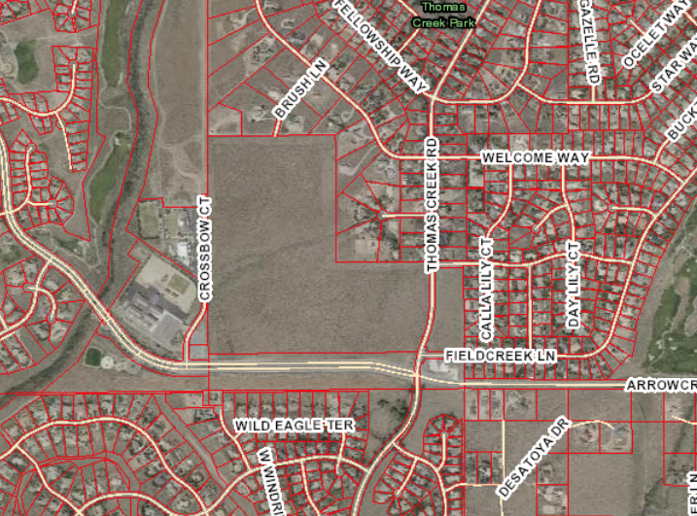
Project Background
U.S. Forest Service – Education Land Grant Act
60 acres of land
Environmental Assessment (EA) process
Public input process
USFS – Decision Notice

Slide 3
Questions?

Slide 4
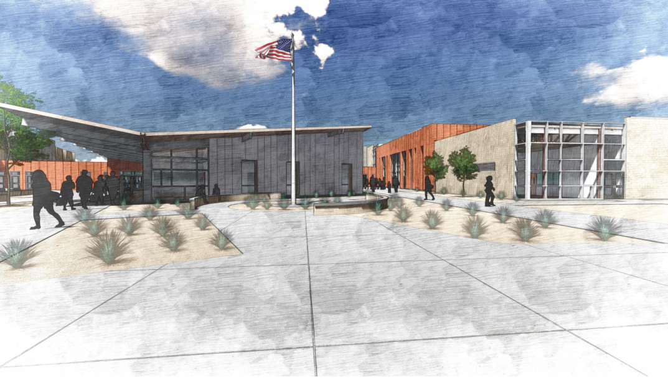
Middle School
at Arrowcreek

